Slide 1
Product Sales at Pens and Printers
A Solution for Optimizing Sales Strategy for
New Product Line of office stationery
Clinton B. Asoh-Itambi
September 14th, 2023.
Notes:
Hello my name is Clinton and I am from the Data Analytics team. I’m going to walk you through how we approach the problem of optimizing the sales strategy for the new product line of office stationery.

Slide 2
Business Goals
Optimize Sales Strategy: Determine the most effective sales strategy for the new product line of office stationery.
Maximize Revenue: Increase revenue generated from the sales of the new product line by selecting the best-performing sales method.
Enhance Customer Acquisition: Identify the sales method that acquires the highest-quality customers and drives customer acquisition for the company.
Improve Efficiency: Optimize resource allocation by selecting a sales method that maximizes revenue while minimizing the time and effort required from the sales team.

Slide 3
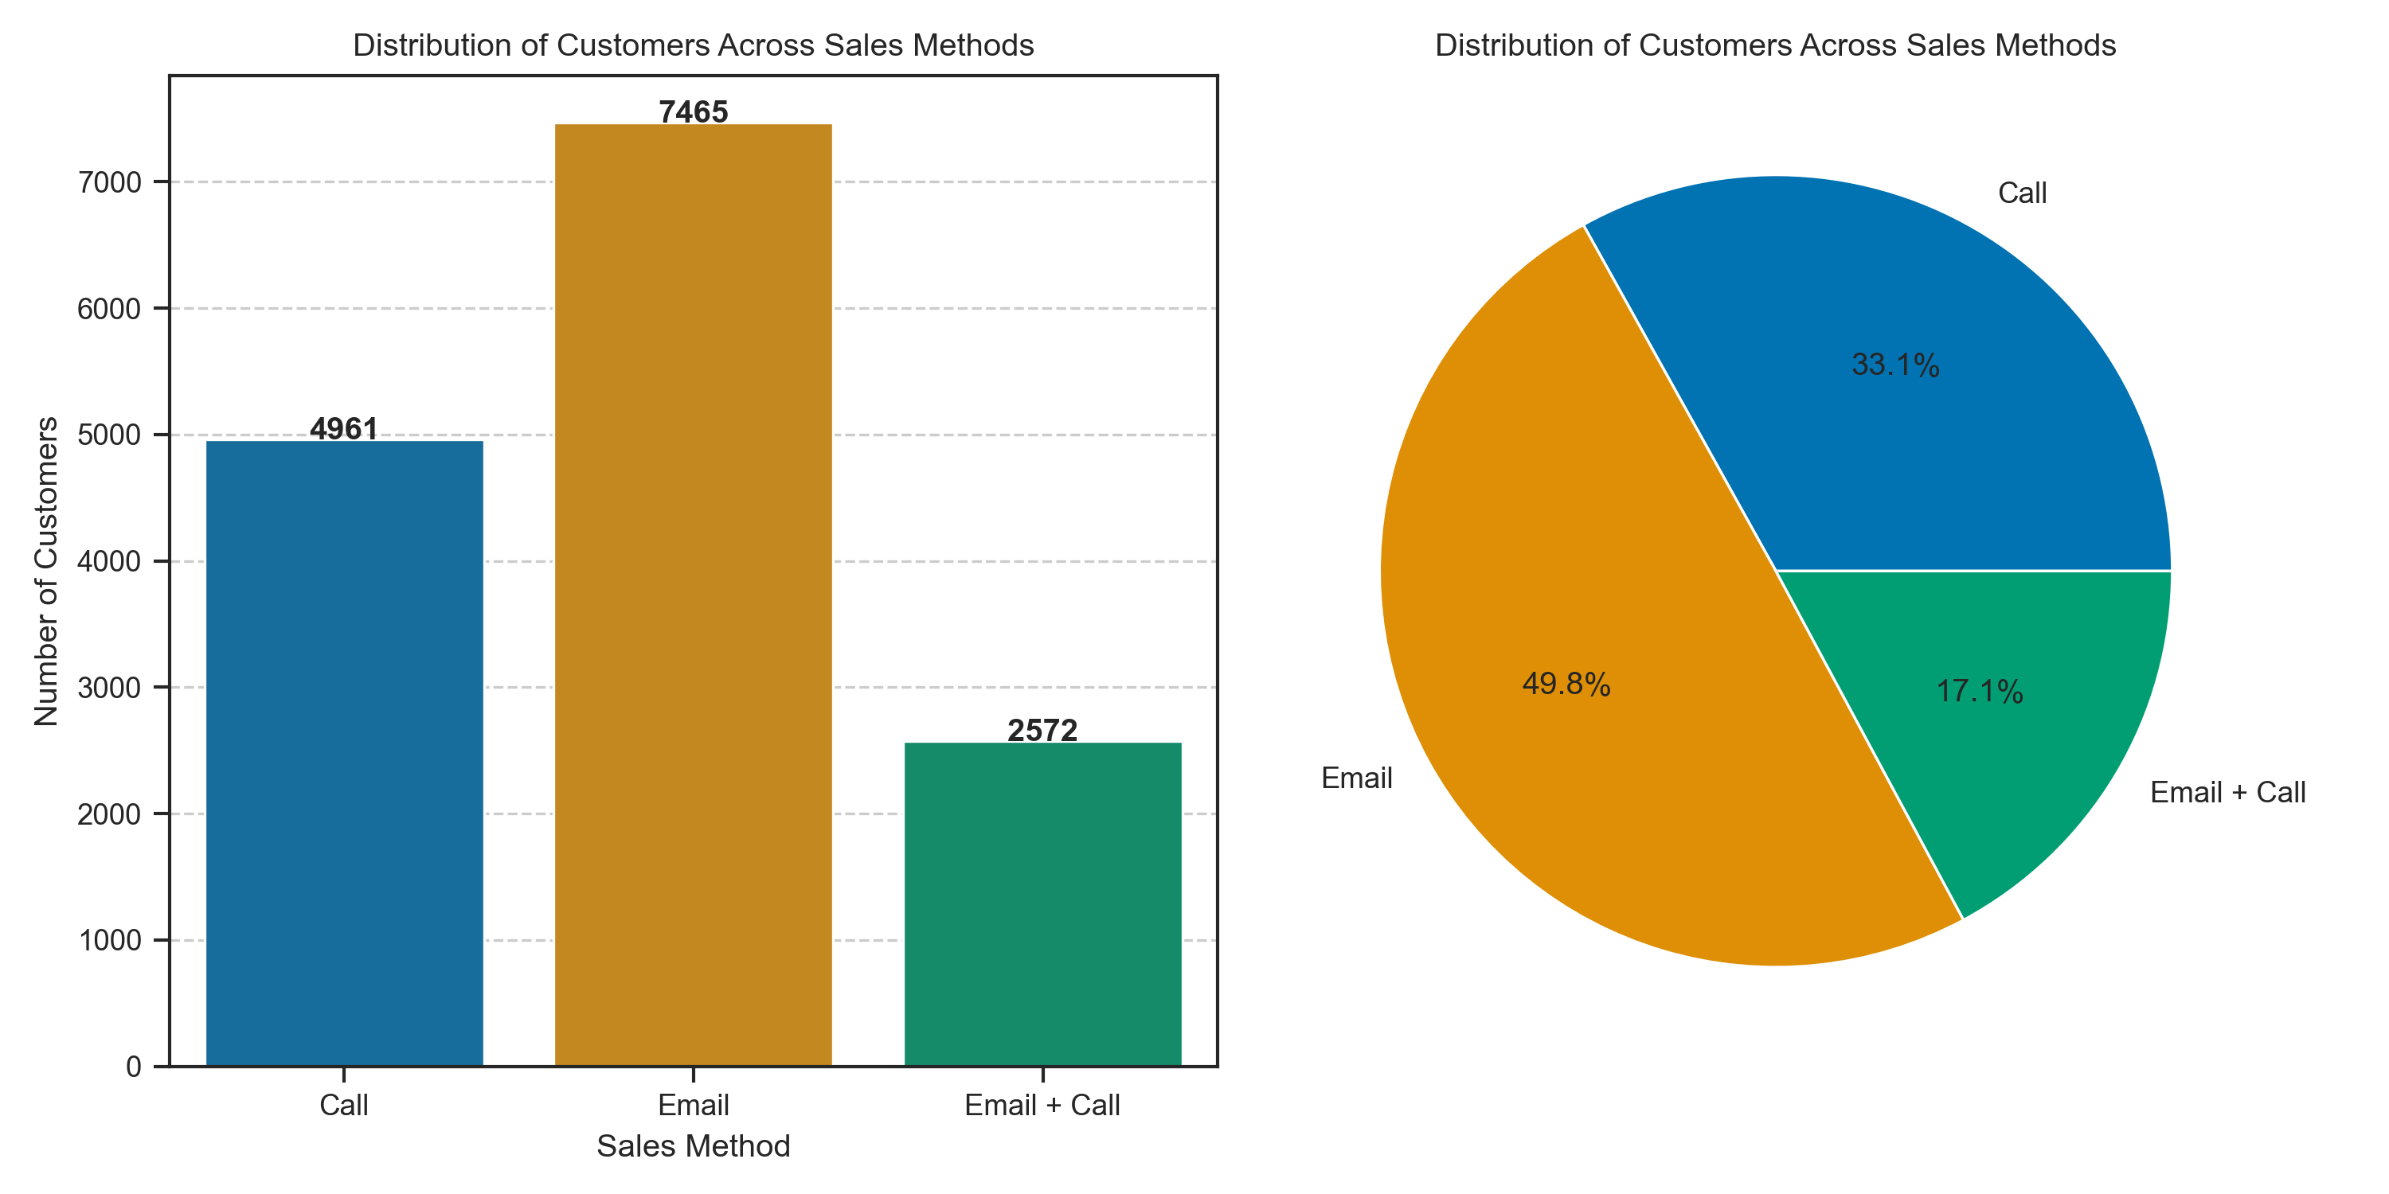
Outcomes
How many customers were there for each approach? – Customer Analysis
Email has the greatest number of customers, 7465, making up 49.8%.
Call has 4961 customers making up 33.1%
Email + Call has the least number of customers, 2572, making up 17.1%.

Slide 4
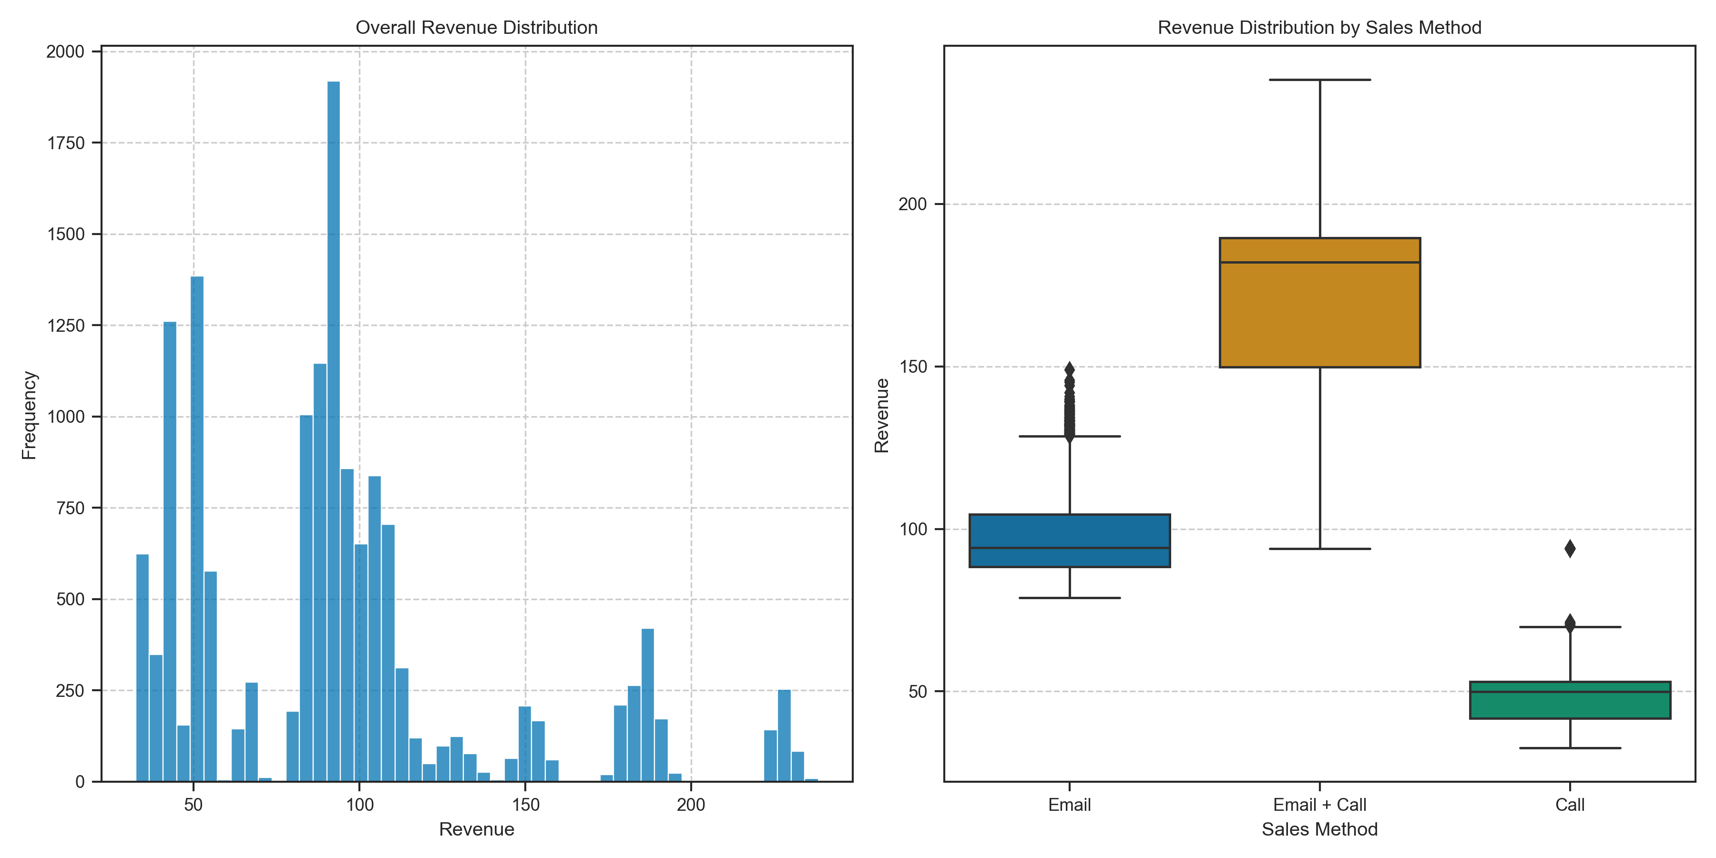
Outcomes
What does the spread of the revenue look like overall? And for each method? – Revenue Analysis
Overall revenue distribution is right-skewed, meaning few customers contribute significantly to revenue.
Email + Call produces the greatest revenue followed by Email.
Call produces the least revenue.

Slide 5
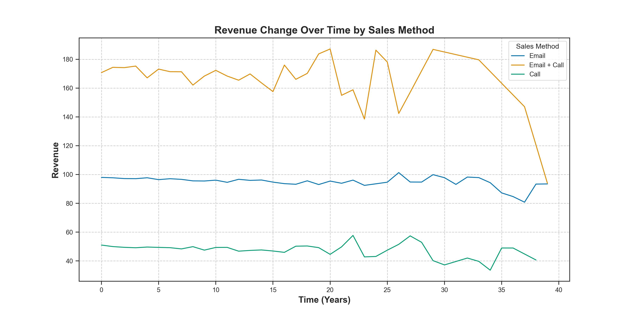
Outcomes
Was there any difference in revenue over time for each of the methods? - Temporal Analysis
Email + Call consistently generates the highest revenue, making it a strategic choice for maximizing profits.
Revenue generally fluctuates non-uniformly for each method as years go by.
Email + Call revenue peaked in 2013, 29 years after the company was founded, and has since dropped to the same level as Email.

Slide 6
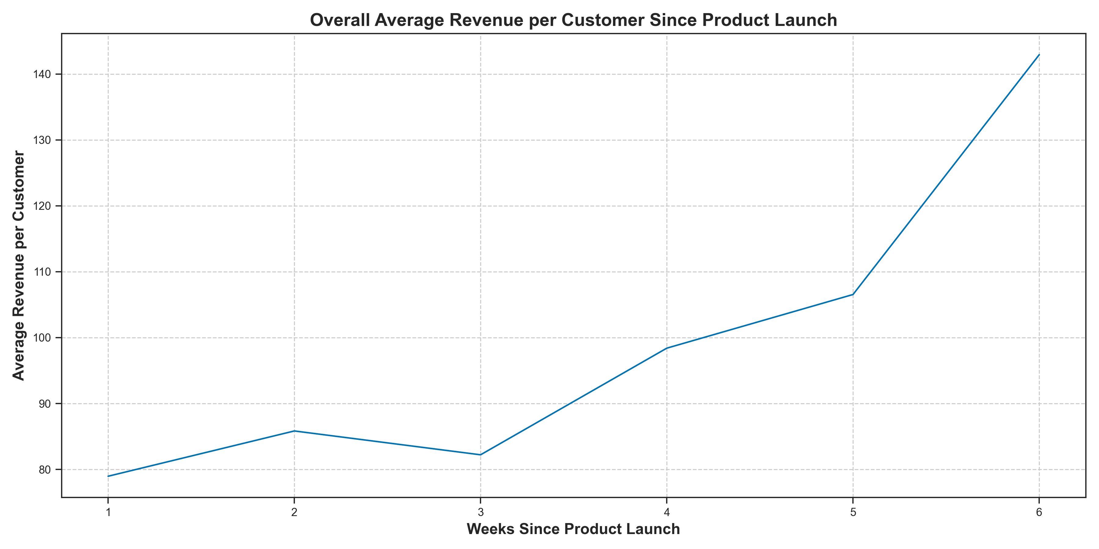
Outcomes
Was there any difference in revenue over time for each of the methods? - Temporal Analysis
The average revenue per customer has been increasing since launch of the new product line, with a small drop in the 3rd week.

Slide 7
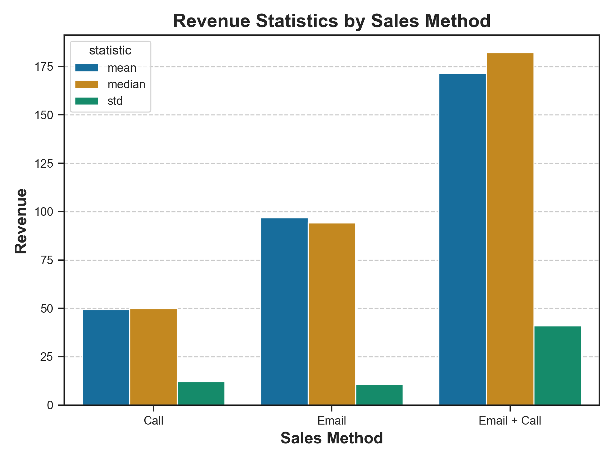
Outcomes
Based on the data, which method would you recommend we continue to use? - Sales Method Recommendation
Despite having fewer customers, Email + Call generates the most revenue, indicating its effectiveness.
Email + Call offers a balance between customer engagement and time efficiency, making it a practical choice.

Slide 8
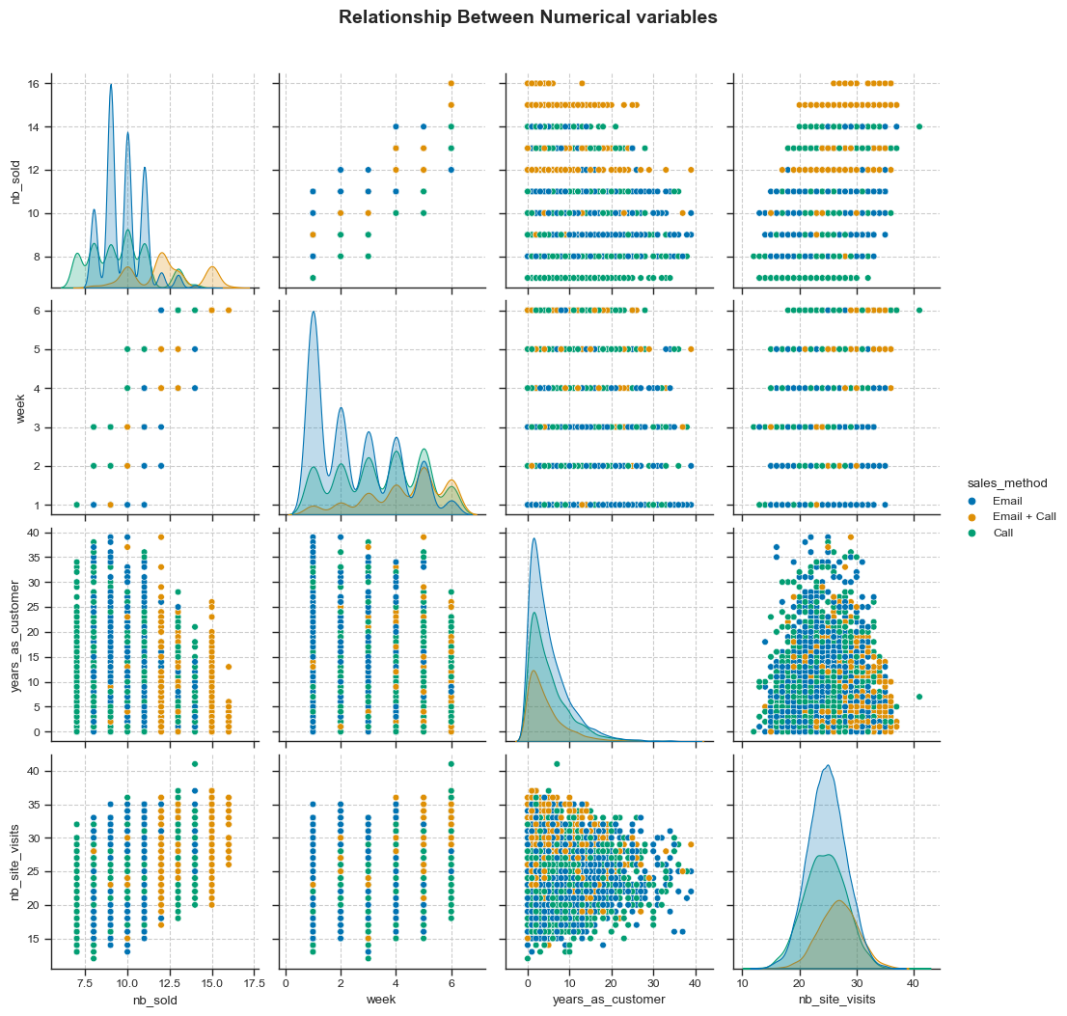
Outcomes
Based on the data, which method would you recommend we continue to use? - Sales Method Recommendation
Continue using Email + Call .
Despite having fewer customers, Email + Call generates the most revenue, indicating its effectiveness.
Email + Call offers a balance between customer engagement and time efficiency, making it a practical choice.
Number of times the customers have visited our website is normally distributed with the greatest mean being from Email + Call.

Slide 9
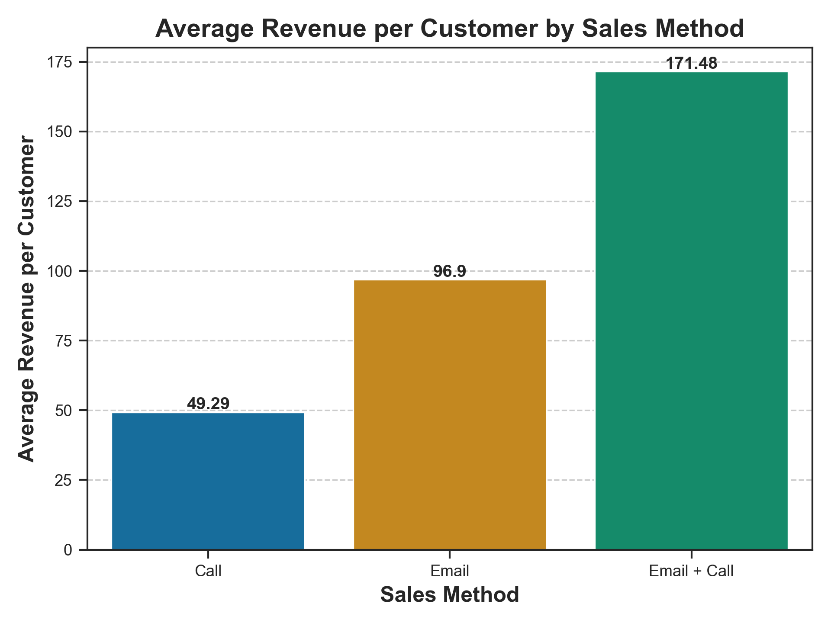
Metric for Business Monitoring
Our KPI: Average Revenue per Customer
Email + Call method stands out with an average revenue per customer of $171.48, significantly higher than the other methods.
This metric enables tracking and assessment of sales performance over time, facilitating data-driven decision-making.

Slide 10
Recommendations
Continue using Email + Call sales method for new office stationery product line, monitoring Average Revenue per Customer.
Continuously monitor and adjust sales method to adapt to changing market conditions.
Consider trade-off between customer volume and revenue when deciding on sales method.
Invest in sales team training and development.
Establish data validation and cleaning processes.
Focus on customer retention strategies in addition to acquisition. Satisfied and loyal customers can provide a steady source of revenue over time.

